Slide 1
Unit 3 -
Basic HTML
Let’s make content and then dress it up

Slide 2
Unit 3
Basic HTML

Slide 3
The Big 3
When you are creating a website there are 3 things that you should always have.
HTML
CSS
JS
With these combined they create a full web page.

Slide 4
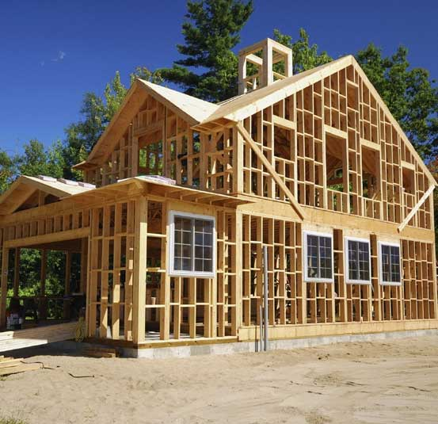
The Website House
When you create a website you can think of it like building a house
The foundation -HTML
This is the content, without content your site can be as flashy as it wants, no one will want to see it.
Everything else is built around this.

Slide 5
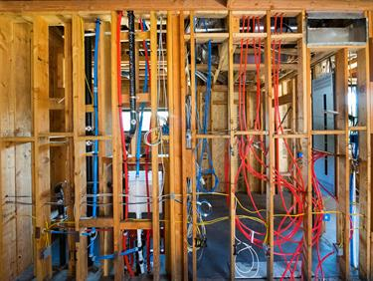
The Website House
Electrical and Plumbing - JS
This is built into the walls, once the walls go up on no will see this working behind the scenes but without them your house will not function.
This is the second thing to be done, and should only be visible while interacting with the site.

Slide 6

The Website House
Paint and furniture - CSS
This is the part that people see and judge you for, while the JS is working in the back the CSS covers it up and makes your site pleasing to look at.
Not required for a functional house but definitely makes it better.

Slide 7
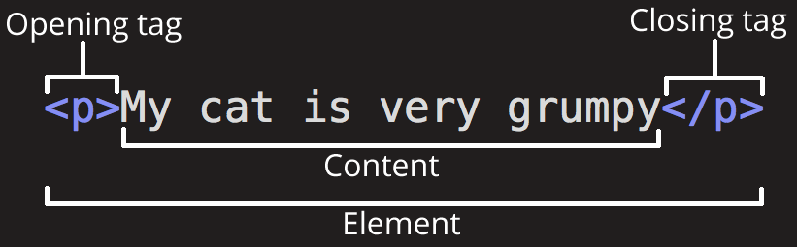
Elements
Any HTML is created using ELEMENTS
Elements come in 3 parts
Opening Tag
Content
Closing tag

Slide 8
Somethings to Know about Elements
HTML is not case sensitive.
<body> = <BODY> = <BoDy> = <Body>
Elements are not magic and they do not create magic letters
Elements just tell your computer how the content will be displayed.
You can overwrite every part of it.
You can create any element you want <anything>
It just won’t make your text different

Slide 9

Nesting Elements
Nesting an element is the same as putting 1 elements inside of another. For example:
<em> is nested in the </p> tag
The most recently opened tag should be closed first.

Slide 10
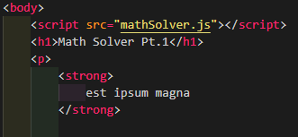
Nesting Elements pt. 2
When you try to add nested elements over a longer area make sure that they are indented in.
Indents are consistent in any coding language.

Slide 11

Empty Elements
Some elements do not need opening and closing tags and are instead just a single opening tag.
For example <img>is just a single tag that you can add information to

Slide 12
Attributes
Attributes are additions to the opening tag that contain extra information that is not visible in the content
You can have as many attributes as you want in a single tag.
Most attributes require an equal sign and a value

Slide 13
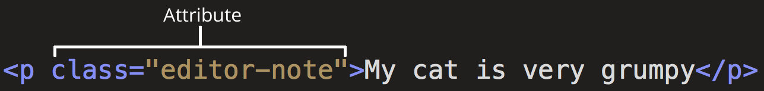
Attributes
Attributes should have:
A space between it and the element name. There should also be spaces between multiple elements
The attribute name, followed by an equal sign
An Attribute value, wrapped with opening and closing quote marks

Slide 14
An example
The <a> tag is an empty element that stands for anchor. It allows you to link to a hyperlink and it has several attributes
<a href=”URL”> will let you link a website to your page
<a title=”title”> Will show a subtitle when you hover over the link
<a target=”_blank”> will open the link in a new tab, If you want to display the linked content in the current tab you can leave this out

Slide 15

Boolean Attributes
These are attributes that only have 1 value, for example the disabled attributed can only have the value “disabled”
When this is the case you are able to write it in shorthand.

Slide 16
Practice
Create a hyperlink reference that will:
Link you to the west-mec homepage
Say West-MEC when you hover over it
Open the page in a new tab

Slide 17
Important parts of an HTML
<!DOCTYPE html>
This is an old relic left over since the early days of html
Just type this at the beginning of your HTML you don’t need to know more than that.

Slide 18
Important parts of an HTML
The <html> tag
This element is the whole page, it covers everything and is the base element.
The <head> tag
This element is a container for all of the information that is not visible content. Keywords, page descriptions, CSS, char sets, etc...

Slide 19
Important parts of an HTML
The <meta charset=”utf-8”> tag
This tag specifies the character set for your document. UTF-8 is a comprehensive set that includes most characters from the majority of human written language.
The <body> tag
This tag contains ALL of the visible content that you want to show to the user, text, images, videos, games, etc...

Slide 20
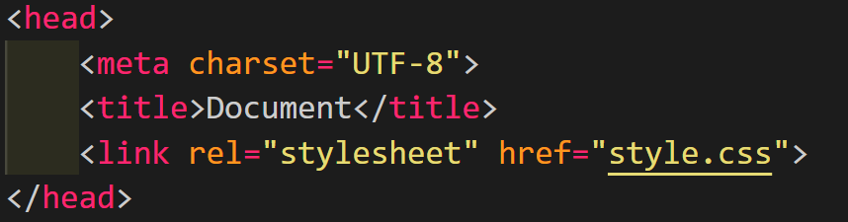
Head Breakdown
There are only 3 important parts that you need in the <head>
What language you are using (utf-8)
The title of the page
The link to the CSS stylesheet

Slide 21
Messing with the Meta
UTF-8 is universal it can handle almost every language and should always be used but let's see one that is not universal
I will post this example of japanese in slack please copy and paste it.
<p>Japanese example: ご飯が熱い。</p>

Slide 22

Messing with the Meta
If you open that japanese text it will appear normal if you are using UTF-8
Now replace the utf-8 with:
You will see the english text normally but the japanese characters will be all messed up

Slide 23
More important Metadata
Meta name and content
There are a ton of things that you can do with name and content.
There are 2 important ones that you should know:
author
description

Slide 24
Signing Your Work
name = author
content = “your name”
This will allow people to look up your name when they are trying to cite your work.

Slide 25
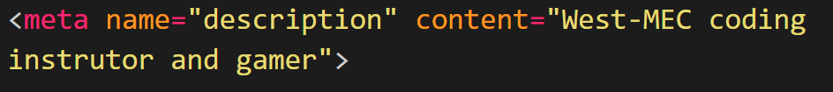
Search Engines
name = description
content = “What is your site about?”
This will allow your site to be found easier by search engines.

Slide 26
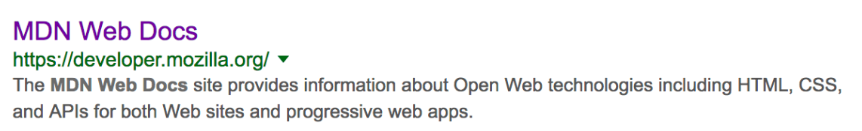
Meta Descriptions
These descriptions are what the user will see when they google your site. For example:

Slide 27
Research time.
I want you to go to the following website
https://yoast.com/meta-descriptions/
What are the 7 Characteristics of a good meta description. Please summarize each point in a 2-3 sentence saying: Why are they important and an important fact to keep in mind about it.

Slide 28
Other Types of Metadata
Open Graph Data https://yoast.com/meta-descriptions/
These are pretty new, created by facebook to show a brief snippet of the site before you actually click the links
Hover over the link below and see what I mean

Slide 29
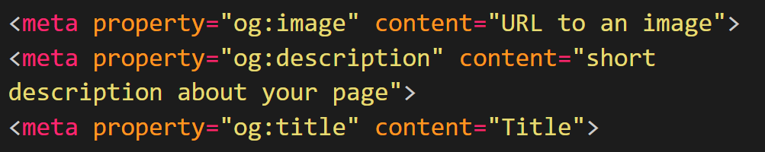
Open Graph Data
Copy these into your coding notebook

Slide 30
Link Tags
The little pictures at the top by the title are called favicons and they can be changed with a link tag
This is the same tag that is used to link the CSS to the page.

Slide 31
Makeup of a Link Tag
<link rel="relation" href="filename" type="image">
rel is the relationship that the file has to the page stylesheet, icon, etc…
href is the hyperlink reference to the image. This can be a URL but it can also be a file name if it is saved on the local server
type is usually not required but it should just be what you are posting.

Slide 32
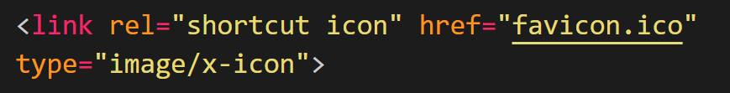
Favicon Link
In order to link a favicon you will need to find a small image or gif
These pictures will be visible on bookmarks as well and can make your website much more recognizable

Slide 33
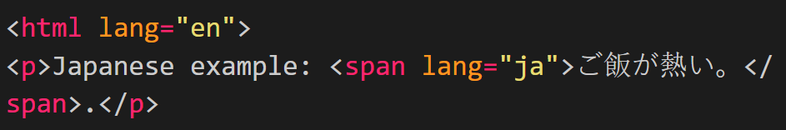
One Last Thing on Starting your Page
Even though UTF-8 CAN run every language you could encounter you should always tell the site what language you plan on using
There are a lot of these and if you are going to change up the language you should change up the lang as well

Slide 34
Project Time
You are going to set up a blank HTML file with everything that you can, use every meta and link tag you can and create a ready to use mockup for examples that we will create soon.
Your title should have a self made favicon that you drew yourself.
Extra: Create one for a chinese resturant

Slide 35
Why we use tags
<h1>
changes the words to have a specific style. This is the same as saying:
<span style="font-size: 32px; margin: 21px 0; display: block;">

Slide 36
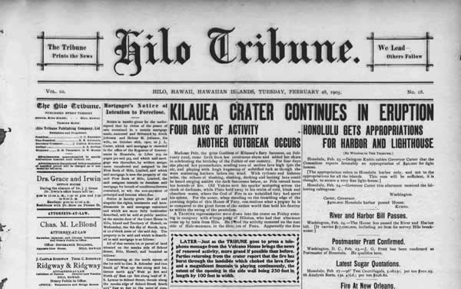
Text Layout
As with most forms of reading (newspapers, etc.) There are headers and paragraphs
By using proper layouts you can make the reading experience much more enjoyable

Slide 37
Headers
When creating headers you will use <h1> - <h6>
<h1> is the most important header, Larger than the rest
<h6> is the least important header, almost the same size as regular text

Slide 38
Text Sections
Now that you have a header you need content text with it to keep the reader interested.
<p> paragraph
Used for just basic text
<aside>
Used for side text or nav or ads. Usually contains <p>
<article>
Used for the main block of the paper usually contains <p> tags

Slide 39
Lists
There are 2 kinds of lists
<ol>
ordered lists - These number your lists 1, 2, 3 …
<ul>
Unordered lists - These do not order your lists

Slide 40
List - Practice
Create a top 10 list of anything you want
(SCHOOL APPROPRIATE AND NO BURGER KING FOOT LETTUCE)
Create a list of 10 items that you will need to buy for groceries.
(This can be made up if you want, also no burger king foot lettuce)

Slide 41
Emphasis - italics
In the past the <i> tag was used for italicized but that has since been deprecated.
Now we use <em> for emphasis
This will not only italicize the word but also make any text readers use emphasis to show importance.

Slide 42
Strong - bold
We used to use <b> for bold but that is deprecated.
Now we use <strong> for text readers

Slide 43
Underline
In the past we used <u> that has also been deprecated so now we use inline style editing
<u style="text-decoration-line: underline">This is fancy</u>

Slide 44
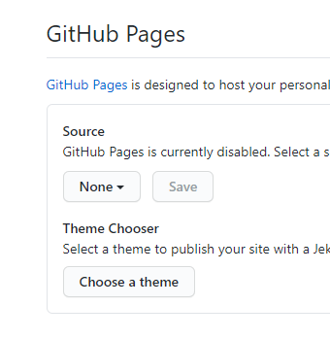
GitHub Pages
This is how you publish a website for free.
Github will host a small website for you for free.
You will have to use the github address with it but it is a real and functional static web site that people can visit!

Slide 45
Project - Recipe Guide
Please read the documentation and then copy the recipe from the second page

Slide 46
Lots of Little Things
Tags that take about a slide each to talk about.

Slide 47
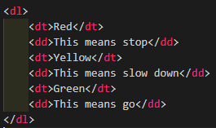
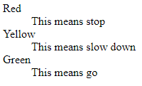
Description Lists
These are used to create a list of items <dt> and a small description under them <dd>

Slide 48
Links
In order to create a link that someone can click on you need to create an <a> tag. This stands for an anchor tag.
An anchor tag looks like this
<a href="West-MEC.org">the West-MEC homepage</a>.

Slide 49
Email Links
You can create links that will open to an email
The default mailer will be Outlook on PC
The name that you type into the href will be automatically put into the send to address.
When you create your href add the mailto:qualifier.
<a href="mailto:kyle.peck@west-mec.org">Send me an email</a>

Slide 50
Advanced Email Links
You can add body and subject in the code as well
%20 is the unicode for a space
<a href= "mailto:nowhere@mozilla.org
?cc=name2@rapidtables.com
&bcc=name3@rapidtables.com
&subject=The%20subject%20of%20the%20email
&body=The%20body%20of%20the%20email">
Send mail with cc, bcc, subject and body </a>

Slide 51
Abbreviations
When you want to shorten a word you need to use the abbr tag
This will let you tell the user, using code, that the word is short for something and add the full word as an attribute
<p>
We use
<abbr title="Hypertext Markup Language">HTML</abbr>
to structure our web documents.
</p>

Slide 52
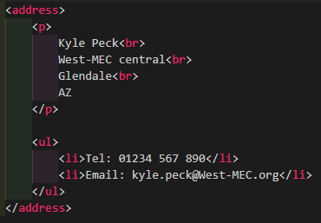
Addresses
The <address> tag is used to distinguish that you listing address information.

Slide 53


Superscript and subscript
If you want to have your numbers a above or below the rest you need <sup> and <sub>

Slide 54
Practice Time
I will post the code on gc, please copy this text into your vsc
You will then edit it with the code we just learned to make it look perfect.

Slide 55
Typing Code in Your HTML
<code>
Formats you text to look like coding font
<pre>
Retains whitespace, useful for indents when typing code
<var>
Signifies it as a variable name
<kbd>
For marking keyboard inputs
<samp>
For marking up the output of a computer program

Slide 56
Practice time
I will post the prompt on GC and then please copy / paste the block of text into your vsc

Slide 57
Times and Dates
<time datetime = “ ”>
There so TONS of ways that you can do date time.
The next 2 slide show a bunch of those ways, PLEASE DO NOT COPY THEM ALL DOWN I WILL NOT ASK YOU ANYTHING THAT SPECIFIC ON THE TEST

Slide 58
Date Times
<!-- Standard simple date -->
<time datetime="2016-01-20">20 January 2016</time>
<!-- Just year and month -->
<time datetime="2016-01">January 2016</time>
<!-- Just month and day -->
<time datetime="01-20">20 January</time>
<!-- Just time, hours and minutes -->
<time datetime="19:30">19:30</time>

Slide 59
Date Times
<!-- You can do seconds and milliseconds too! -->
<time datetime="19:30:01.856">19:30:01.856</time>
<!-- Date and time -->
<time datetime="2016-01-20T19:30">7.30pm, 20 January 2016</time>
<!-- Date and time with timezone offset -->
<time datetime="2016-01-20T19:30+01:00">7.30pm, 20 January 2016 is 8.30pm in France</time>
<!-- Calling out a specific week number -->
<time datetime="2016-W04">The fourth week of 2016</time>

Slide 60
Basic Parts of a Webpage
What do all the sites share and how to start?

Slide 61
Exploration Time
Please visit these sites
https://www.youtube.com/
https://en.wikipedia.org/wiki/Main_Page
https://www.imdb.com/
https://www.amazon.com/
Take some time and find as many similarities with the layout as you can. Your list should be at least 7 items long

Slide 62
Header
Header
The header is a large strip at the top of the page
Usually this includes the logo, a search bar, the name of the company or site, or sometimes the motto.
This is also usually the part of the site with most colors and sets the theme for the rest of the site

Slide 63
Navigation Bar
This is a smaller bar, usually under the header bar or sometimes included in the header bar
This is a list of all the places that you can go to on the site and provides a nice organization to the site.
The nav bar should be consistent across the whole site, when you move to a new page the bar should not change.
While you can include it in the header it is better to have it separate since it helps with screen readers

Slide 64
Article
The main content of your work
This is usually in the center of the page and take up the most space in the layout
This can be almost everything depending on what the focus of your website is for

Slide 65
Sidebar
Referred to as the <aside> tag, it appears on the edge of the screen
This runs along side of the article
Holds links to related content, recently visited link, or ads that run.
Usually has different colors or fonts
Can be used as a secondary navbar in some site

Slide 66
Footer
A small strip along the bottom of the page
Contains copyright, cites, names of authors, addresses, and/or phone numbers
Usually a smaller print and something that is an afterthought, a place only the more invested users look to
The footer can also be used for SEO (Search Engine Optimization)

Slide 67
Tags for the Parts
Header
Navigation Bar
Main
Sidebar
Footer
<header>
<nav>
<article>, <main>, <section>, and <div>
<aside> and <div>
<footer>

Slide 68
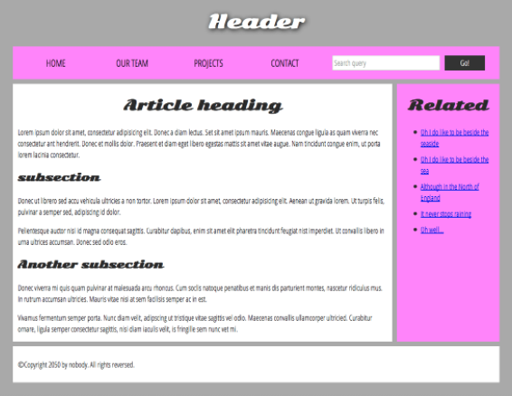
The Basic WebSite can Look Like...

Slide 69
Non-Specific Tags
There are 2 tags that you can use for anything (not that you should)
The <div> tag should be used when you want to declare a special class or id in the code.
<div id="copyright">©Copyright 2050 by Me.</div>

Slide 70
Non-Specific Tags
<span> is used for smaller changes that you want to apply within the text.
<p>
<span style="font-size: larger;">©Copyright</span> 2050 by nobody.
</p>

Slide 71

Horizontal Rule
You can add a long line across your page that will help you section off your work
It is a great way to seperate your sections in a blog or in a new article setting

Slide 72
Unicode
Unicode is the reserved code that the computer has for symbols and text.
I will post a couple unicode sites on GC
When creating Unicode use &# ; and the code
&#128516; = 😄

Slide 73
Practice Time
Please type your name out using only Unicode.
First Name
Last Name
3 emojis on how you are feeling today

Slide 74
Web Forms
Finally some good stuff...

Slide 75
Web Form Intro
Web forms are the most basic way to collect information from the user.
Forms allow the user to enter data and allows the coder to format the data, you can qualify what can go where.
Normally this information is then sent to storage on a server

Slide 76
The <form> Element
When you use <form> to create a form there are 2 important attributes that you need keep in mind
action = “URL”
This defines where the forms collected data should be stored when it is submitted
method = “post”
This defines which HTTP method to send the data with, usually equals “get” or “post”

Slide 77

<label> element
When creating form inputs it is good (not required) to always include labels on all of your form inputs.
The label will have a for attribute that will associate with an id attribute in the prompt.
This should also be where you add the header for the input area

Slide 78

<input> Element
The input element will create a small line where you are able to input code
List of attributes that are always included:
Id = “” : This is the same as the for in the label
type = “” : This has a few values but should match the expected input
name = “” : How you will identify this input

Slide 79
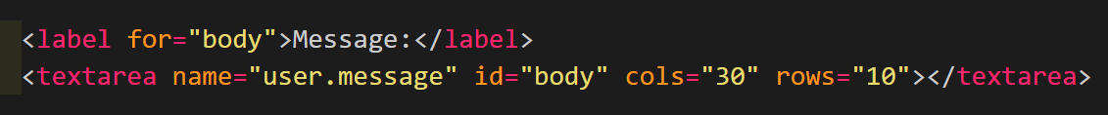
<textarea> element
This will create a large are that someone can enter in paragraphs or longer messages.
Required attributes:
id = “” : that matches the for
name = “” : that is unique to the input
Non-Required attributes:
cols = “#” rows = “#” : will increase the size of the box

Slide 80
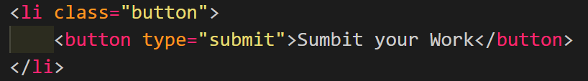
<button> Element
This will create a small button on the page that the user can interact with
There is only 1 attribute we care about right now and that is the type
type = “” : can be submit, reset, or button.
Submit will send the information to the action attribute of the form element.

Slide 81
<fieldset> & <legend>
When creating any kind of widget on HTML (like a form) you should always use fieldset and legend.
<fieldset> signifies that the content between will be in a single group
<legend> titles the fieldset and helps screen readers.

Slide 82
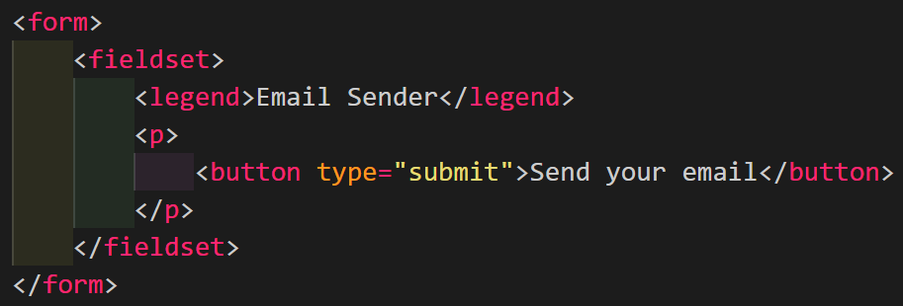
<fieldset> & <legend>

Slide 83
Exploring Time!
Use the internet to find the code to do the following
How do you make a button reset your inputs?

Slide 84
Exploring Time!
Use the internet to find the code to do the following
How do you make an input box uneditable. (grey it out)?

Slide 85
Exploring Time!
Use the internet to find the code to do the following
How do you create an input that accepts files?
Make sure it only accepts .jpg and .jpeg files.

Slide 86
Exploring Time!
Use the internet to find the code to do the following
How do you make a checkbox?
Add a checkbox for 4 different medical symptoms

Slide 87
Exploring Time!
Use the internet to find the code to do the following
How do you obscure a text field for a password?

Slide 88
Exploring Time!
Use the internet to find the code to do the following
How do you make radio buttons ?
0 - 12
13-20
21+

Slide 89
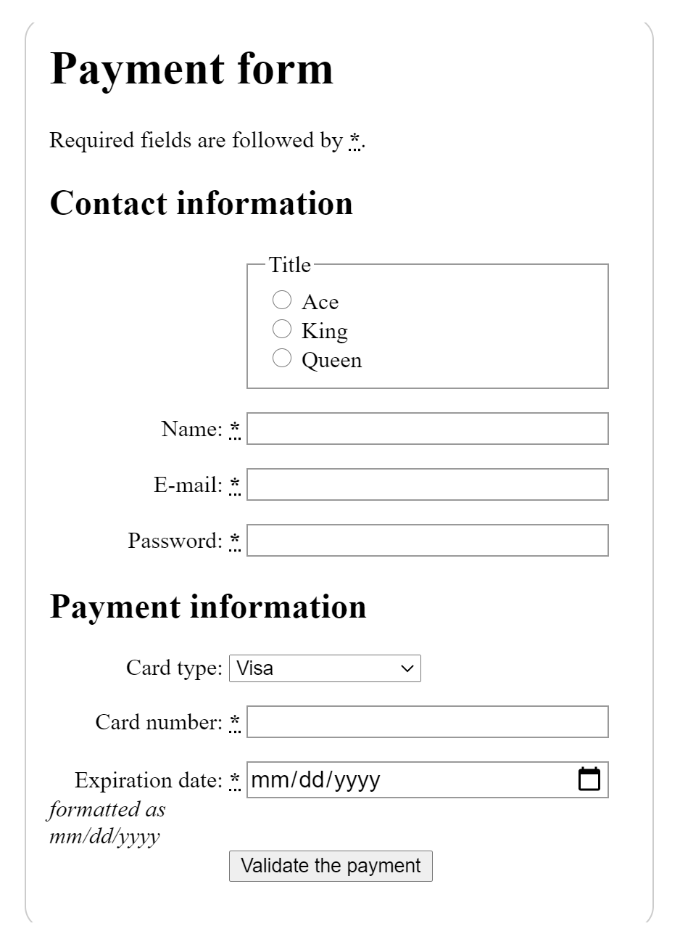
Basic Form Layout
We are going to recreate the form on the right
Please make a new folder in Unit 3 called Basic Form Layout

Slide 90
Adding More Pages
You can create a multi page project by using your a tags to link to new pages.
All you need to do is have the href relative to the file you are linking from.
<a href="aboutUs.html">About Us</a>

Slide 91
Multimedia Embedding
Adding videos, images, and audio

Slide 92
Images
<img src=URL> how you post a picture that is associated with that address.
The URL can also be a file in your directory if you have it downloaded and saved
<img src="images/face.png">

Slide 93
Images
Create a new folder in your element practice folder named “images”
Then please download 2-3 pictures (SCHOOL APPROPRIATE) and save them in that folder

Slide 94
Images
When you are defining Images you should also define an alternate text that will display incase the image brakes, get corrupted, isn’t supported, or doesn’t exist anymore.
To do this you need to use the alt=”description” attribute
This also works with screen readers.

Slide 95
images
You should be defining the width and height for images as well.
This can be a percent of the page or a flat pixel amount (pixel is better) but if you don’t define it then your formatting will look very gross.
width= “” height= “”

Slide 96
Images
Images also need titles, a short description that the user will see when they hover over the image.
title = “description”

Slide 97
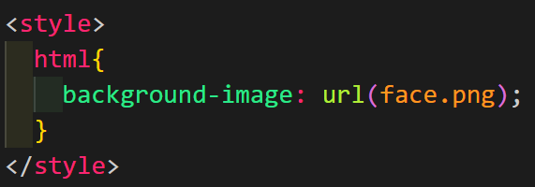
Background Images
You can also add background images at any time by using CSS
Let’s add an inline style tag and make one of the images a background image.

Slide 98
Video
The moving pictures

Slide 99
Video element
To add a video to your page you can use the <video> tag
Just like images and anything else that uses another file in the system you need to use the attribute src

Slide 100
Videos
Videos are different from images because we need to start, stop, pause, rewind, etc…
In order to control the video we need to add the control attribute

Slide 101
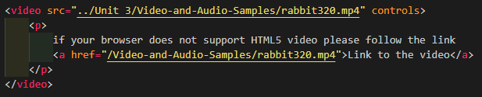
Videos
When creating a video you can add text in the block incase the video breaks.
This should be link to the video for people whose browsers can’t handle it
This is usually done with a <p> tag

Slide 102
Videos
Different devices and different software can access these videos in different ways and may expect different formats in order to work properly.
Because of this it is usually best to provide the same video in multiple formats so you can fix it. You do this with the <source> tag

Slide 103
Video BONUS ATTRIBUTES
Width and height
same as image
Autoplay
video will play when it loads
Loop
video will repeat when it ends
Muted
video loads with the sound off
Poster=”URL”
loads an image at the start of the video, kind of like a thumb nail

Slide 104
Video BONUS ATTRIBUTES
The last attribute is preload and it has 3 values
preload = “none”
This does not buffer the file
preload =”auto”
Buffers the media file
preload =”metadata
Buffers only the metadata for the file (not very useful videos)

Slide 105
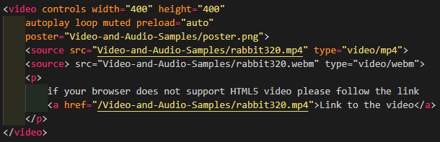
A Proper Video Format

Slide 106
Audio
Basically video but without the video

Slide 107
Audio - Differences
Audio does not support width and height since there are no images to size
It also does not support the poster attribute since there is no place to put an opening thumbnail
Everything else is the same

Slide 108
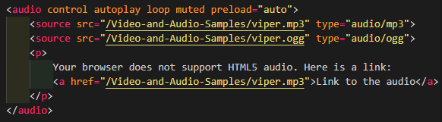
Proper Audio Format

